Slide 1
JSON & Spring
Run Spring Server !!!
Dr Simon Lock
simon.lock@bristol.ac.uk

Slide 2
Aim of this session
Introduce the concept of JSON
Explore uses of JSON in development
Look at some basic parsing & interrogation
Consider more sophisticated parsing tools
What you will see today are MINIMAL examples
Just enough to get something up and running
You’ll probably want to extend & improve them !

Slide 3
What is JSON ?
Soz if you know this all already…
Didn’t want to take anything for granted
JSON - JavaScript Object Notation
Originally designed for transfer of JS “objects”
But adopted by many other prog. languages
Allow us to “Flat-pack” objects into textual format
For storage on a filesystem…
Or transfer across a network

Slide 4
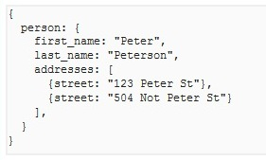
Example JSON document
JSON looks a bit like a programming language
(it is the data struct definition part of JS after all)
However there is NO behavioural aspect
It just consists of name:value pairs
Where values can be:
Atomic (e.g. an int)
Complex (an object)
An array (of things)

Slide 5
Why should we care ?
JSON is used EVERYWHERE
Particular for transferring data to/from web services
Some JSON web services your might know of:
The Facebook “Graph”
National Rail enquiries (the “Huxley” proxy)
Met Office weather
Magic Seaweed live surf feed
Open Project !
etc.

Slide 6
Freedom !
One of the nice things about JSON is the freedom
Developers are free to define their own structure
You can put what you want, where you want it :o)
As a result many JSON documents are very ugly !
As we shall see later on !!!

Slide 7
Parsing JSON
Parsing involves reading in the JSON text…
And reconstructing it as a set of “live” objects
We don’t need to do this ourselves !
Various parsers already exist to do this for us
We will take a look at a couple of them shortly
Note: Parsing is not the end of the story though
We have to interrogate the created objects to extract data that we need for our application

Slide 8
Spring Application
To illustrate JSON in Spring, we need an app !
Let’s make an app to interrogate OP !
Web Browser
Spring Server
OP Server

Slide 9
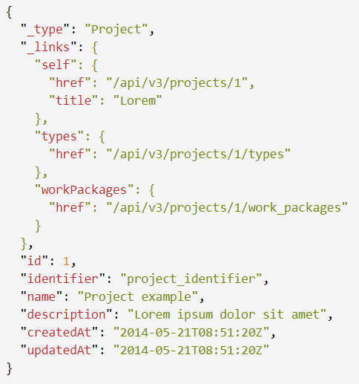
Example JSON for a project in OP

Slide 10
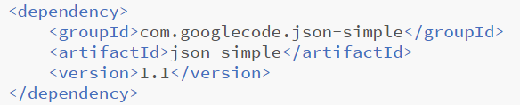
JSON-Simple
Simple, lightweight and fast parser
Provides basic features for reading/writing JSON
It’s not covered by Spring Initializr :o(
So manually add a dependency to the pom file:

Slide 11
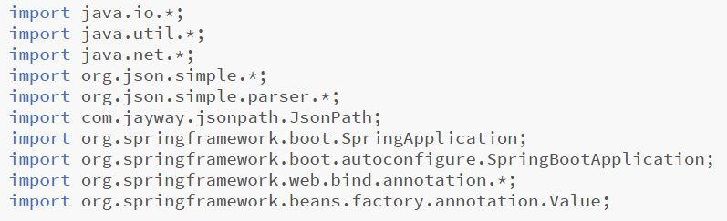
Imports

Slide 12
Using JSON-Simple
Based around JSONObject and JSONArray
They provide entity and collection structures
(Basically extensions of HashMap and ArrayList)
Documentation can (currently) be found here:
http://alex-public-doc.s3.amazonaws.com/
json_simple-1.1/index.html
To pull out entities, we use the “get” methods…

Slide 13
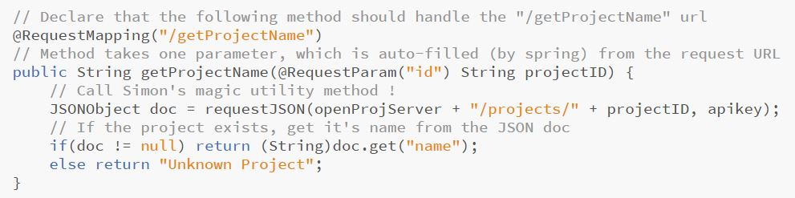
Requesting a project name (by ID)
http://127.0.0.1:8080/getProjectName?id=14

Slide 14
A more complex example?
Tally up the different types of work package in a project
For example: 3 phases, 5 tasks, 4 milestones

Slide 15
Design
When method is called, a project ID is passed in
We must query Open Project about that project
Then loop through all the work packages returned
They might be a “phase”, “task” or “milestone”
We need a running count (tally) of each WP type
Once tallied up, the number of each type should be returned to the browser for display

Slide 16
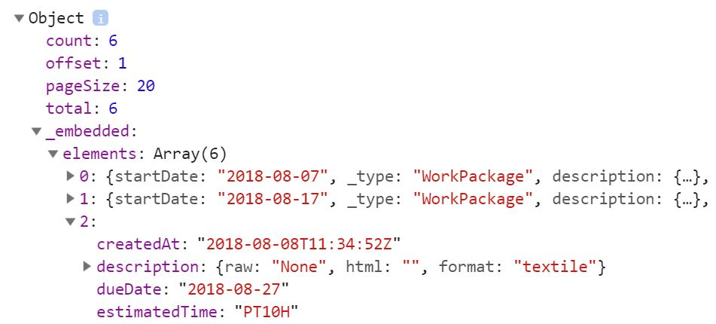
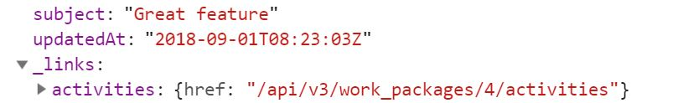

https://opserver/projects/{id}/work_packages
document
embedded
elements
2nd work package
links
type

Slide 17
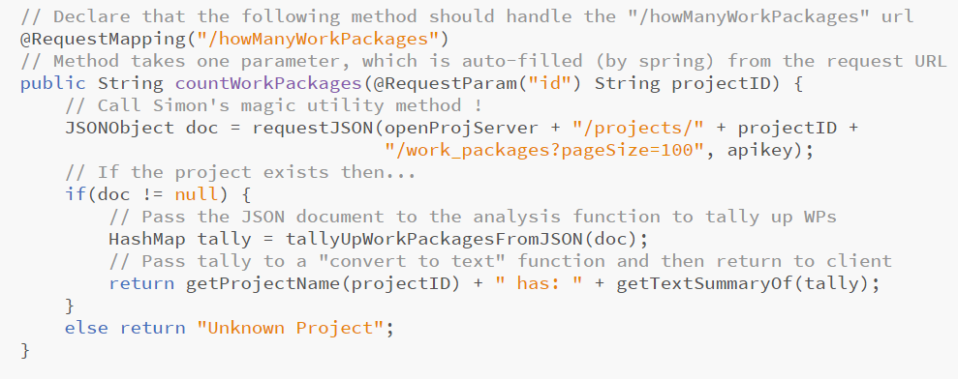
Count of work package types (by ID)
http://127.0.0.1:8080/howManyWorkPackages?id=17

Slide 18
Do we all know about HashMaps ?
Provides a fast access key:value pair store
A bit like a dictionary in Python
Uses a fancy indexing mechanism for efficiency
How it is implemented isn’t important right now
All we need to know is that it looks like this:
Key <String> | Value <Integer>
“phase” | 3
“task” | 5
“milestone” | 4

Slide 19
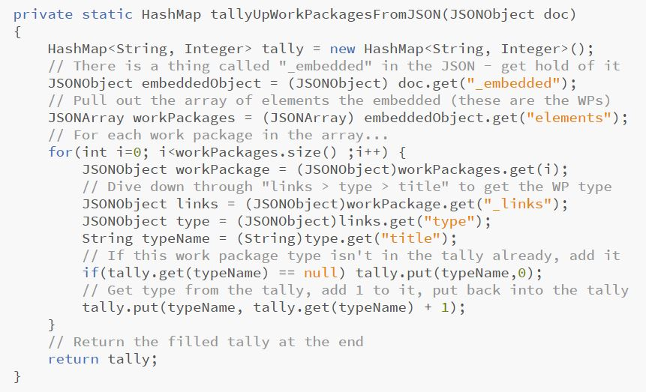
Interrogate the JSON

Slide 20
Anything we haven’t covered ?

Slide 21
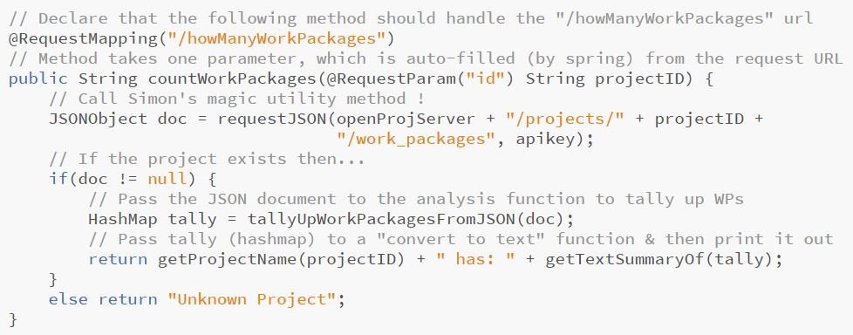
Simon’s magic utility method !

Slide 22
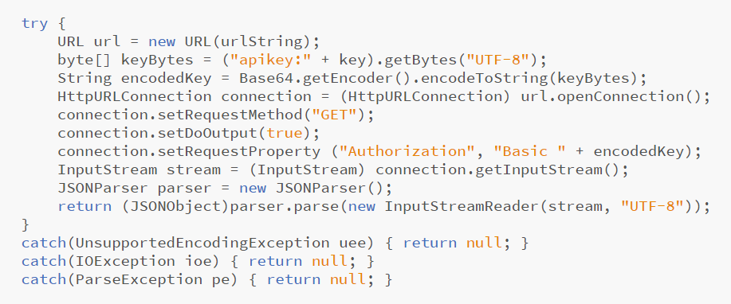
Making HTTP Requests in Spring
https://opserver/projects/{id}/work_packages

Slide 23
“Basic” Authorization (with API Key)

Slide 24
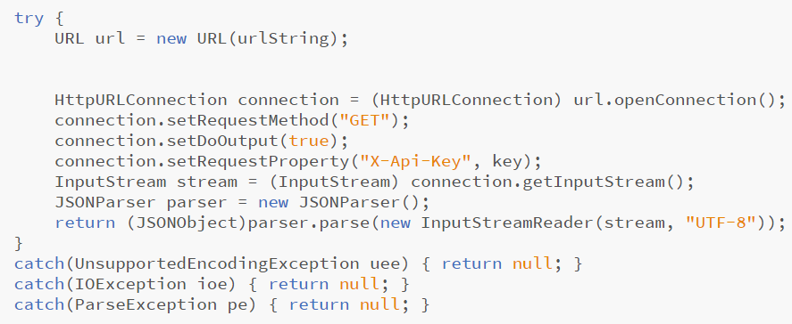
X-Api-Key Header Authentication

Slide 25
Next week on “SPE”
Generating JSON
(rather than just consuming it)
More sophisticated parsers
(parsers do more, YOU do less)
More efficient data transfer
(streamlining data transfer for speed-ups)

